Slide 1
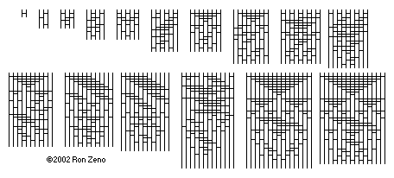
Theoretical Bounds on Sorting
Lecture 33 (Sorting 4)
CS61B, Fall 2023 @ UC Berkeley
Slides credit: Josh Hug
Notes:
http://www.angelfire.com/blog/ronz/Articles/999SortingNetworksReferen.html

Slide 2
Goal: How Hard is Sorting?
Goal: How Hard is Sorting?
Math Problem Warmup
Theoretical Bounds on Sorting
Simple Bounds for TUCS (the ultimate comparison sort)
Puppy Cat Dog (N = 3, N = 4)
Puppy Cat Dog for Any N
The Sorting Lower Bound
Sounds of Sorting
Lecture 34, CS61B, Fall 2023

Slide 3
Sorts Summary
 | Memory | # Compares | Notes | Stable?
Heapsort | Θ(1) | Θ(N log N) | Bad caching (61C) | No
Insertion | Θ(1) | Θ(N²) | Best for almost sorted and N < 15 | Yes
Mergesort | Θ(N) | Θ(N log N) | Fastest stable sort | Yes
Quicksort LTHS | Θ(log N) | Θ(N log N) expected | Fastest sort | No
This is due to the cost of tracking recursive calls by the computer, and is also an “expected” amount. The difference between log N and constant memory is trivial.
You can create a stable Quicksort. However, using unstable partitioning schemes (like Hoare partitioning) and using randomness to avoid bad pivots tend to yield better runtimes.

Slide 4
Sorting
Sorting is a foundational problem.
Obviously useful for putting things in order.
But can also be used to solve other tasks, sometimes in non-trivial ways.
Sorting improves duplicate finding from a naive N² to N log N.
Sorting improves 3SUM from a naive N³ to N².
There are many ways to sort an array, each with its own interesting tradeoffs and algorithmic features.
Today we’ll discuss the fundamental nature of the sorting problem itself: How hard is it to sort?

Slide 5
Math Problem Warmup
Goal: How Hard is Sorting?
Math Problem Warmup
Theoretical Bounds on Sorting
Simple Bounds for TUCS (the ultimate comparison sort)
Puppy Cat Dog (N = 3, N = 4)
Puppy Cat Dog for Any N
The Sorting Lower Bound
Sounds of Sorting
Lecture 34, CS61B, Fall 2023

Slide 6
A Math Problem out of Nowhere
Consider the functions N! and (N/2)^{N/2}
Is N! ∈ Ω((N/2)^{N/2})? Prove your answer.
Recall that ∈ Ω can be informally be interpreted to mean ≥
In other words, does factorial grow at least as quickly as (N/2)^{N/2}?

Slide 7
A Math Problem out of Nowhere
Consider the functions N! and (N/2)^{N/2}
Is N! ∈ Ω((N/2)^{N/2})? Prove your answer.
10!
10 * 9 * 8 * 7 * 6 * … * 1
5⁵
5 * 5 * 5 * 5 * 5
N! > (N/2)^{N/2}, for large N, therefore N! ∈ Ω((N/2)^{N/2})

Slide 8
Another Math Problem
Given: N! > (N/2)^{N/2}, which we used to prove our answer to the previous problem.
Show that log(N!) ∈ Ω(N log N).
Recall: log means an unspecified base.

Slide 9
Another Math Problem
Given that N! > (N/2)^{N/2}
Show that log(N!) ∈ Ω(N log N).
We have that N! > (N/2)^{N/2}
Taking the log of both sides, we have that log(N!) > log((N/2)^{N/2}).
Bringing down the exponent we have that log(N!) > N/2 log(N/2).
Discarding the unnecessary constant, we have log(N!) ∈ Ω(N log (N/2)).
From there, we have that log(N!) ∈ Ω(N log N).
Since log(N/2) is the same thing asymptotically as log(N).
In other words, log(N!) grows at least as quickly as N log N.

Slide 10
Last Math Problem
In the previous problem, we showed that log(N!) ∈ Ω(N log N).
Now show that N log N ∈ Ω(log(N!)).

Slide 11
Last Math Problem
Show that N log N ∈ Ω(log(N!))
Proof:
log(N!) = log(N) + log(N-1) + log(N-2) + …. + log(1)
N log N = log(N) + log(N) + log(N) + … log(N)
Therefore N log N ∈ Ω(log(N!))

Slide 12
Omega and Theta: yellkey.com/TODO
Given:
N log N ∈ Ω(log(N!))
log(N!) ∈ Ω(N log N)
Which of the following can we say?
N log N ∈ Θ(log N!)
log N! ∈ Θ(N log N)
Both A and B
Neither
Notes:
https://docs.google.com/forms/d/e/1FAIpQLSc7OfRNg4Vj8G3h4tuA6VL30gnD8gjWbThyRjiDWmAR2B8f1g/viewform

Slide 13
Omega and Theta
Given:
N log N ∈ Ω(log(N!))
log(N!) ∈ Ω(N log N)
Which of the following can we say?
N log N ∈ Θ(log N!)
log N! ∈ Θ(N log N)
Both A and B
Neither
Informally: N log N ≥ log(N!)
Informally: log(N!) ≥ N log N
Informally: N log N = log(N!)

Slide 14
Summary
We’ve shown that log(N!) ∈ Θ(N log N).
In other words, these two functions grow at the same rate asymptotically.
As for why we did this, we will see in a little while...

Slide 15
Simple Bounds for TUCS (the ultimate comparison sort)
Goal: How Hard is Sorting?
Math Problem Warmup
Theoretical Bounds on Sorting
Simple Bounds for TUCS (the ultimate comparison sort)
Puppy Cat Dog (N = 3, N = 4)
Puppy Cat Dog for Any N
The Sorting Lower Bound
Sounds of Sorting
Lecture 34, CS61B, Fall 2023

Slide 16
Sorting
We have shown several sorts to require Θ(N log N) worst case time.
Can we build a better sorting algorithm?
Let the ultimate comparison sort (TUCS) be the asymptotically fastest possible comparison sorting algorithm, possibly yet to be discovered, and let R(N) be its worst case runtime.
Give the best Ω and O bounds you can for R(N).
It might seem strange to give Ω and O bounds for an algorithm whose details are completely unknown, but you can, I promise!
By comparison sort, I mean that it uses e.g. the compareTo method in Java to make decisions.

Slide 17
Sorting
We have shown several sorts to require Θ(N log N) worst case time.
Can we build a better sorting algorithm?
Let the ultimate comparison sort (TUCS) be the asymptotically fastest possible comparison sorting algorithm, possibly yet to be discovered, and let R(N) be its worst case runtime.
By comparison sort, I mean that it uses e.g. the compareTo method in Java to make decisions.
O(N log N)
Worst case run-time of TUCS, R(N) is O(N log N).
Obvious: Mergesort is Θ(N log N) so R(N) can’t be worse!
Worst case run-time of TUCS, R(N) is Ω(1).
Obvious: Problem doesn’t get easier with N.
Can we make a stronger statement than Ω(1)?
Ω(1)
TUCS Worst
Case Θ Runtime

Slide 18
Sorting
Let TUCS be the asymptotically fastest possible comparison sorting algorithm, possibly yet to be discovered.
Worst case run-time of TUCS, R(N) is O(N log N). Why?
Worst case run-time of TUCS, R(N) is also Ω(N).
Have to at least look at every item.
O(N log N)
Ω(N)
TUCS Worst
Case Θ Runtime

Slide 19
Sorting
We know that TUCS “lives” between N and N log N.
Worst case asymptotic runtime of TUCS is between Θ(N) and Θ(N log N).
Can we make an even stronger statement on the lower bound?
With a clever argument, yes (as we’ll see soon see).
Spoiler alert: It will turn out to be Ω(N log N)
This lower bound means that across the infinite space of all possible ideas that any human might ever have for sorting using sequential comparisons, NONE has a worst case runtime that is better than Θ(N log N).
O(N log N)
Ω(N)
TUCS Worst
Case Θ Runtime

Slide 20
Puppy Cat Dog (N = 3, N = 4)
Goal: How Hard is Sorting?
Math Problem Warmup
Theoretical Bounds on Sorting
Simple Bounds for TUCS (the ultimate comparison sort)
Puppy Cat Dog (N = 3, N = 4)
Puppy Cat Dog for Any N
The Sorting Lower Bound
Sounds of Sorting
Lecture 34, CS61B, Fall 2023

Slide 21
Sorting
We know that TUCS “lives” between N and N log N.
Worst case asymptotic runtime of TUCS is between Θ(N) and Θ(N log N).
Can we make an even stronger statement on the lower bound?
With a clever argument, yes (as we’ll see soon see).
Spoiler alert: It will turn out to be Ω(N log N)
This lower bound means that across the infinite space of all possible ideas that any human might ever have for sorting using sequential comparisons, NONE has a worst case runtime that is better than Θ(N log N).
O(N log N)
Ω(N)
TUCS Worst
Case Θ Runtime

Slide 22
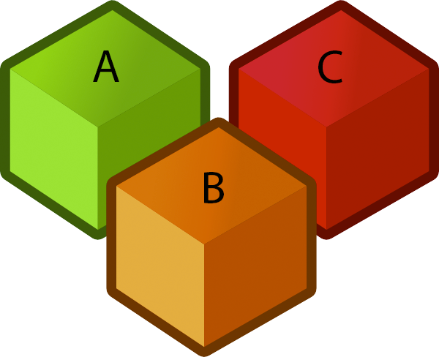


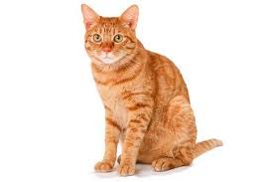

The Game of Puppy, Cat, Dog
Suppose we have a puppy, a cat, and a dog, each in an opaque soundproof box labeled A, B, and C. We want to figure out which is which using a scale.
Notes:
Cubes: http://www.clker.com/cliparts/6/9/3/2/1197122947130754155jean_victor_balin_Cubes.svg.hi.png
Scale: http://www.clipartbest.com/cliparts/94T/bAe/94TbAejig.png
Puppy:http://assets.nydailynews.com/polopoly_fs/1.1245686!/img/httpImage/image.jpg_gen/derivatives/article_970/afp-cute-puppy.jpg
Cat: http://animalia-life.com/cat.html
Dog: http://animalia-life.com/dogs.html

Slide 23
The Game of Puppy, Cat, Dog
Suppose we have a puppy, a cat, and a dog, each in an opaque soundproof box labeled A, B, and C. We want to figure out which is which using a scale.
a < b | b < c |  | Which is which?
Yes | Yes

Slide 24
The Game of Puppy, Cat, Dog
Suppose we have a puppy, a cat, and a dog, each in an opaque soundproof box labeled A, B, and C. We want to figure out which is which using a scale.
a < b | b < c |  | Which is which?
Yes | Yes |  | a: puppy, b: cat, c: dog (sorted order: abc)
No | No

Slide 25
The Game of Puppy, Cat, Dog
Suppose we have a puppy, a cat, and a dog, each in an opaque soundproof box labeled A, B, and C. We want to figure out which is which using a scale.
a < b | b < c |  | Which is which?
Yes | Yes |  | a: puppy, b: cat, c: dog (sorted order: abc)
No | No |  | c: puppy, b: cat, a: dog (sorted order: cba)

Slide 26
The Game of Puppy, Cat, Dog: http://yellkey.com/TODO
Suppose we have a puppy, a cat, and a dog, each in an opaque soundproof box labeled A, B, and C. We want to figure out which is which using a scale.
Which is which?
a: puppy, b: cat, c: dog (sorted order: abc)
a: puppy, c: cat, b: dog (sorted order: acb)
c: puppy, a: cat, b: dog (sorted order: cab)
c: puppy, b: cat, a: dog (sorted order: cba)
a < b | b < c |  | Which is which?
Yes | Yes |  | a: puppy, b: cat, c: dog (sorted order: abc)
No | No |  | c: puppy, b: cat, a: dog (sorted order: cba)
Yes | No
Notes:
https://docs.google.com/forms/d/e/1FAIpQLSf8TV2sUc2-SxIKTdhI3cgaPdcag1LUn4UTughkFNNaqsWAlg/viewform

Slide 27
The Game of Puppy, Cat, Dog
Suppose we have a puppy, a cat, and a dog, each in an opaque soundproof box labeled A, B, and C. We want to figure out which is which using a scale.
Which is which? How do we resolve the ambiguity?
a: puppy, b: cat, c: dog (sorted order: abc)
a: puppy, c: cat, b: dog (sorted order: acb)
c: puppy, a: cat, b: dog (sorted order: cab)
c: puppy, b: cat, a: dog (sorted order: cba)
a < b | b < c |  | Which is which?
Yes | Yes |  | a: puppy, b: cat, c: dog (sorted order: abc)
No | No |  | c: puppy, b: cat, a: dog (sorted order: cba)
Yes | No
a? c? b
c? a? b

Slide 28
The Game of Puppy, Cat, Dog
Suppose we have a puppy, a cat, and a dog, each in an opaque soundproof box labeled A, B, and C. We want to figure out which is which using a scale.
Which is which? How do we resolve the ambiguity? Ask if a < c.
a: puppy, b: cat, c: dog (sorted order: abc)
a: puppy, c: cat, b: dog (sorted order: acb)
c: puppy, a: cat, b: dog (sorted order: cab)
c: puppy, b: cat, a: dog (sorted order: cba)
a < b | b < c | a < c? | Which is which?
Yes | Yes | N/A | a: puppy, b: cat, c: dog (sorted order: abc)
No | No | N/A | c: puppy, b: cat, a: dog (sorted order: cba)
Yes | No | Yes | a: puppy, c: cat, b: dog (sorted order: acb)

Slide 29
Puppy, Cat, Dog - A Graphical Picture for N = 3
The full decision tree for puppy, cat, dog:
Is a < b?
No
Yes
Is a < c?
Is b < c?
No
Yes
No
Yes
a: puppy
b: cat
c: dog
Is b < c?
b a c
Is a < c?
a b c
No
Yes
No
Yes
c: puppy
a: cat
b: dog
a: puppy
c: cat
b: dog
c b a
b c a
c a b
a c b

Slide 30
The Game of Puppy, Cat, Dog, yellkey.com/TODO
How many questions would you need to ask to definitely solve the “puppy, cat, dog, walrus” problem?
3
4
5
6
Notes:
https://docs.google.com/forms/d/e/1FAIpQLSfwjP1UTp38YwotowMSNR169vrEFAPzckl_v83omPc2tf_9KQ/viewform

Slide 31
The Game of Puppy, Cat, Dog
How many questions would you need to ask to definitely solve the “puppy, cat, dog, walrus” problem?
3
4
5
6
Proof:
If N=4, how many permutations? 4! = 24
For N=3: 3!=6
So we need a binary tree with 24 leaves.
How many levels minimum? lg(24) = 4.58, so 5 is the minimum.
lg just means log₂ (log base 2)

Slide 32
Puppy Cat Dog for Any N
Goal: How Hard is Sorting?
Math Problem Warmup
Theoretical Bounds on Sorting
Simple Bounds for TUCS (the ultimate comparison sort)
Puppy Cat Dog (N = 3, N = 4)
Puppy Cat Dog for Any N
The Sorting Lower Bound
Sounds of Sorting
Lecture 34, CS61B, Fall 2023

Slide 33
Generalizing Puppy, Cat, Dog
How many questions would you need to ask to definitely solve the generalized “puppy, cat, dog” problem for N items?
Give your answer in big Omega notation.
Hint: For N=4, we said the answer was 5 based on the following argument:
Decision tree needs 4! = 24 leaves.
So we need lg(24) rounded up levels or 5.

Slide 34
Generalizing Puppy, Cat, Dog
How many questions would you need to ask to definitely solve the generalized “puppy, cat, dog” problem for N items?
Give your answer in big Omega notation.
Hint: For N, we have the following argument:
Decision tree needs N! leaves.
So we need lg(N!) rounded up levels, which is Ω(log(N!))
Answer: Ω(log(N!))

Slide 35
Generalizing Puppy, Cat, Dog
Finding an optimal decision tree for the generalized version of puppy, cat, dog (e.g. N=6: puppy, cat, dog, monkey, walrus, elephant) is an open problem in mathematics.
(To my knowledge) Best known trees known for N=1 through 15 and N=22:
For more, see: http://oeis.org/A036604
Deriving a sequence of yes/no questions to identify puppy, cat, dog is hard. An alternate approach to solving the puppy, cat, dog problem:
Sort the boxes using any generic sorting algorithm.
Leftmost box is puppy.
Middle box is cat.
Right box is dog.

Slide 36
Sorting, Puppies, Cats, and Dogs
Why do we care about these (no doubt adorable) critters?
A solution to the sorting problem also provides a solution to puppy, cat, dog.
In other words, puppy, cat, dog reduces to sorting.
Thus, any lower bound on difficulty of puppy, cat, dog must ALSO apply to sorting.
Physics analogy: Climbing a hill with your legs (CAHWYL) is one way to solve the problem of getting up a hill (GUAH).
Any lower bound on energy to GUAH must also apply to CAHWYL.
Example bound: Takes m*g*h energy to climb hill, so using legs to climb the hill takes at least m*g*h energy.

Slide 37
The Sorting Lower Bound
Goal: How Hard is Sorting?
Math Problem Warmup
Theoretical Bounds on Sorting
Simple Bounds for TUCS (the ultimate comparison sort)
Puppy Cat Dog (N = 3, N = 4)
Puppy Cat Dog for Any N
The Sorting Lower Bound
Sounds of Sorting
Lecture 34, CS61B, Fall 2023

Slide 38
Sorting Lower Bound
We have a lower bound on puppy, cat, dog, namely that it takes Ω(log(N!)) comparisons to solve such a puzzle in the worst case.
Since sorting with comparisons can be used to solve puppy, cat, dog, then sorting also takes Ω(log(N!)) comparisons in the worst case.
Or in other words:
Any sorting algorithm using comparisons, no matter how clever, must use at least k = lg(N!) compares to find the correct permutation. So even TUCS takes at least lg(N!) comparisons.
lg(N!) is trivially Ω(log(N!)), so TUCS must take Ω(log(N!)) time.
So, how does log(N!) compare to N log N?
O(N log N)
Ω(log(N!))
TUCS Worst
Case Θ Runtime

Slide 39
Another Math Problem
Earlier, we showed that log(N!) ∈ Ω(N log N) using the proof below.
In other words, log(N!) grows at least as quickly as N log N.
Proof from earlier that log(N!) ∈ Ω(N log N):
We know that N! ≥ (N/2)^{N/2}.
Taking the log of both sides, we have that log(N!) ≥ log((N/2)^{N/2}).
Bringing down the exponent we have that log(N!) ≥ N/2 log(N/2).
Discarding unnecessary constants, we have log(N!) ∈ Ω(N log N)
Recall that changing base is just multiplying by a constant.

Slide 40
The Sorting Lower Bound (Finally)
Since TUCS is Ω(lg N!) and lg N! is Ω(N log N), we have that TUCS is Ω(N log N).
Any comparison based sort requires at least order N log N comparisons in its worst case.
O(N log N)
Ω(N log N)
TUCS Worst
Case Θ Runtime

Slide 41
The Sorting Lower Bound (Finally)
Since TUCS is Ω(lg N!) and lg N! is Ω(N log N), we have that TUCS is Ω(N log N).
Any comparison based sort requires at least order N log N comparisons in its worst case.
Proof summary:
Puppy, cat, dog is Ω(lg N!), i.e. requires lg N! comparisons.
TUCS can solve puppy, cat, dog, and thus takes Ω(lg N!) compares.
lg(N!) is Ω(N log N)
This was because N! is Ω(N/2)^{N/2}
Informally: TUCS ≥ puppy, cat, dog ≥ log N! ≥ N log N
O(N log N)
Ω(N log N)
TUCS Worst
Case Θ Runtime

Slide 42
Optimality
 | Memory | # Compares | Notes | Stable?
Heapsort | Θ(1) | Θ(N log N) | Bad caching (61C) | No
Insertion | Θ(1) | Θ(N²) | Best for almost sorted and N < 15 | Yes
Mergesort | Θ(N) | Θ(N log N) | Fastest stable sort | Yes
Quicksort LTHS | Θ(log N) | Θ(N log N) expected | Fastest sort | No
The punchline:
Our best sorts have achieved absolute asymptotic optimality.
Mathematically impossible to sort using fewer comparisons.
Note: Randomized quicksort is only probabilistically optimal, but the probability is extremely high for even modest N. Are you worried about quantum teleportation? Then don’t worry about Quicksort.

Slide 43
Next Time...
Today we proved that any sort that uses comparisons has runtime Ω(N log N).
Next time we’ll discuss how we can sort in Θ(N) time.
Not impossible, just can’t compare anything while we sort!

Slide 44
Sounds of Sorting
Goal: How Hard is Sorting?
Math Problem Warmup
Theoretical Bounds on Sorting
Simple Bounds for TUCS (the ultimate comparison sort)
Puppy Cat Dog (N = 3, N = 4)
Puppy Cat Dog for Any N
The Sorting Lower Bound
Sounds of Sorting
Lecture 34, CS61B, Fall 2023

Slide 45
Sounds of Sorting Algorithms (of 125 items)
Starts with selection sort: https://www.youtube.com/watch?v=kPRA0W1kECg
Insertion sort: https://www.youtube.com/watch?v=kPRA0W1kECg&t=0m9s
Quicksort: https://www.youtube.com/watch?v=kPRA0W1kECg&t=0m38s
Mergesort: https://www.youtube.com/watch?v=kPRA0W1kECg&t=1m05s
Heapsort: https://www.youtube.com/watch?v=kPRA0W1kECg&t=1m28s
LSD sort: https://www.youtube.com/watch?v=kPRA0W1kECg&t=1m54s [coming in a future lecture]
MSD sort: https://www.youtube.com/watch?v=kPRA0W1kECg&t=2m10s [coming in a future lecture]
Shell’s sort: https://www.youtube.com/watch?v=kPRA0W1kECg&t=3m37s [bonus from an earlier lecture]
Questions to ponder (later… after class):
How many items for selection sort?
Why does insertion sort take longer / more compares than selection sort?
At what time stamp does the first partition complete for Quicksort?
Could the size of the input to mergesort be a power of 2?
What do the colors mean for heapsort?
How many characters are in the alphabet used for the LSD sort problem? (after we learn about it)
How many digits are in the keys used for the LSD sort problem? (after we learn about it)

Slide 46
Extra: Sorting Implementations
Goal: How Hard is Sorting?
Math Problem Warmup
Theoretical Bounds on Sorting
Simple Bounds for TUCS (the ultimate comparison sort)
Puppy Cat Dog (N = 3, N = 4)
Puppy Cat Dog for Any N
The Sorting Lower Bound
Sounds of Sorting
Lecture 34, CS61B, Fall 2023

Slide 47
A Note on Implementations
Concrete implementations are nice for solidifying understanding.
Implementing these yourself provides much deeper understanding than just reading my code.
You are not responsible for the details of these specific implementations.
Given enough time, you should be able to implement any of these sorts.

Slide 48
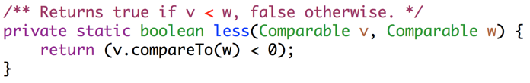
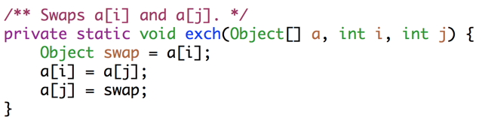
Utility Methods For Sorting

Slide 49
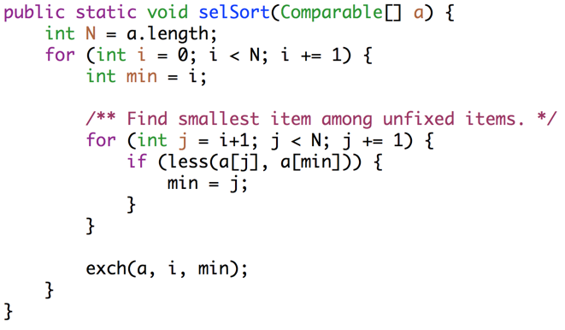
Selection Sort
Key ideas: Among unfixed items, find minimum in Θ(N) time and swap to the front. Subproblem has size N-1. Total runtime is N + N-1 + … + 1 = Θ(N²).

Slide 50
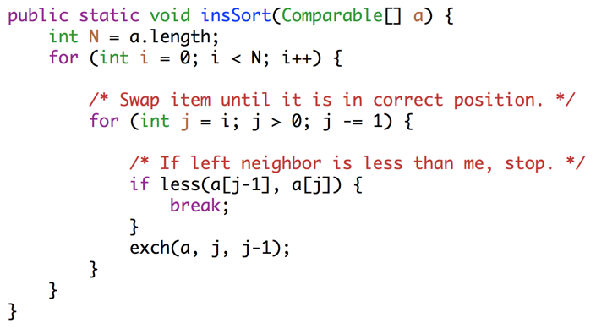
Insertion Sort
Key ideas: For each item (starting at leftmost), swap leftwards until in place. For item k, takes Θ(k) worst case time. Runtime is 1 + 2 + … + N = Θ(N²).

Slide 51
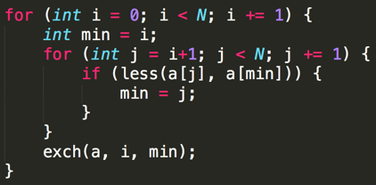
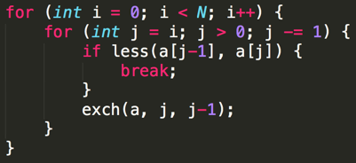
Selection and Insertion Sort Runtimes (Code Analysis)
Selection sort: Runtime is independent of input, always Θ(N²).
~N²/2 compares and ~N²/2 exchanges. Θ(N²) runtime.
Insertion sort: Runtime is strongly dependent on input. Ω(N), O(N²)
Best case (sorted): ~N compares, 0 exchanges: Θ(N)
Worst case (reverse sorted): ~N²/2 compares, ~N²/2 exchanges: Θ(N²)

Slide 52
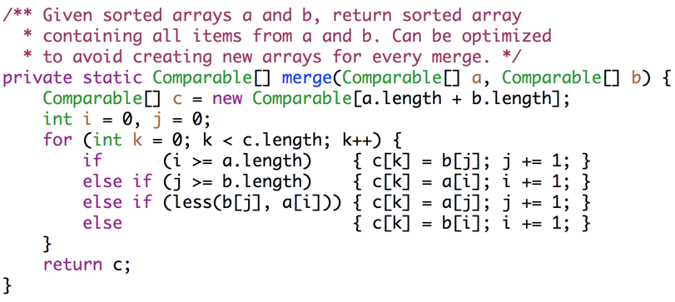
Mergesort (Merge Method)

Slide 53
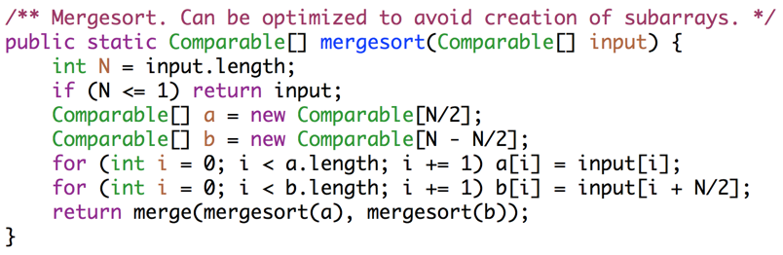
Mergesort
Key ideas: Each merge costs Θ(N) time and Θ(N) space, and generates two subproblems of size N/2. At level L of the sort, there are 2^{L} subproblems of size N/2^{L}. Since L = Θ(log N), runtime is Θ(N log N).

Slide 54
Interview Question
How can the above mergesort implementation be improved?
Try and avoid making copies a and b, by adding parameters to the merge routine. merge(input, 0, 5, 6, 10);
Use a diferent for small N: Like maybe insertion sort. Industrial strength mergesorts, use insertion sort for N < 15.

Slide 55
Interview Question
How can the above mergesort implementation be improved?

Slide 56
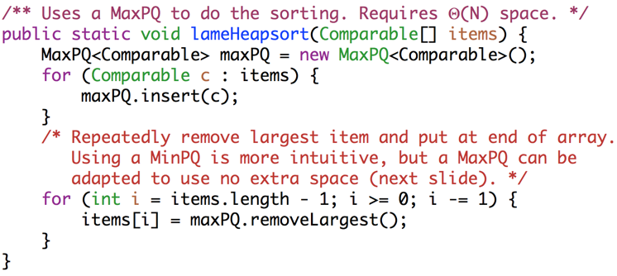
Heapsort With Separate PQ
Key ideas: Create a max heap of all items [Θ(N log N)], then delete max N times [Θ(log N) per delete]. Requires Θ(N) space.

Slide 57
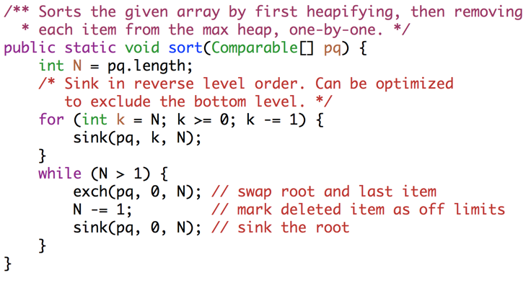
In-Place Heapsort (with root in position 0).
Key ideas: Max-Heapfiy [Θ(N)], then delete max N times [Θ(log N) per delete]

Slide 58
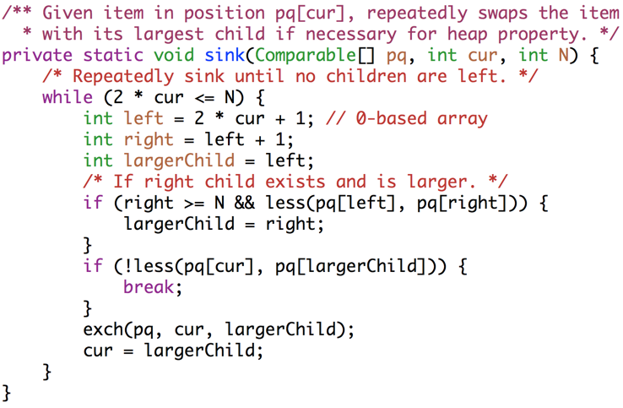
In-Place Heapsort Sink Operation (with root in position 0).

